Slide 1


Getting started with Rails
Rodrigo Rodríguez

Slide 2
Conceptos básicos en Web (1/2)

Slide 3
Rails
Agile development Framework
Created by David Heinemeier in 2005
Installing rails can be done as a standalone installer or by using RubyGems

Slide 4
Rails principles
Convention over Configuration
DRY (Don’t repeat yourself)
Model-View-Controller
RESTFul

Slide 5
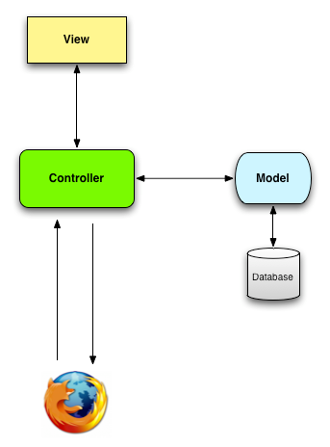
Model-View-Controller
Architectural pattern, which enforces a separation between “domain logic” from the input and presentation logic associated with a graphical user interface (GUI).

Slide 6
RESTful
Representational State Transfer architecture tries to ease the way we represent the transference of information.
Two principles:
  Using resource identifiers such as URLs to represent resources.
  Transferring representations of the state of that resource between system components.
DELETE /photos/17
http://www.infoq.com/articles/rest-introduction

Slide 7

Rails Components
Action Pack
  Action Controller
  Action Dispatch
  Action View
Action Mailer
Active Model
Active Record
Active Resource
Active Support
Railties

Slide 8
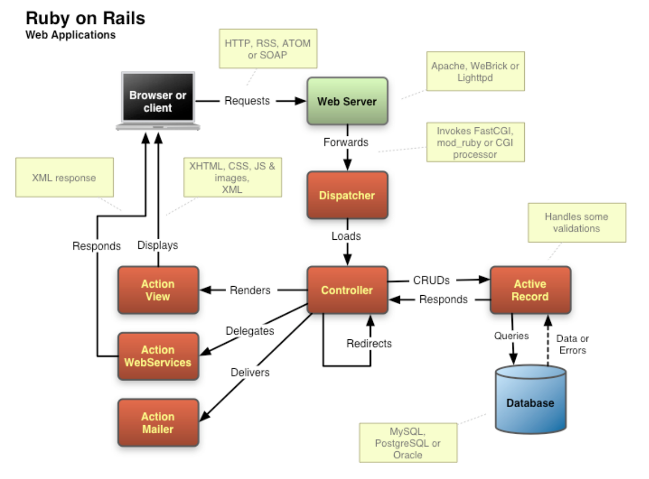

Slide 9
File organization
app: Core application (app) code, including models, views, controllers, and helpers
config: Application configuration
db: Files to manipulate the database
doc: Documentation for the application
lib: Library modules
log: Application log files
public: Data accessible to the public
script/rails: A script provided by Rails for generating code, opening console sessions, or starting a local web server

Slide 10
File organization
test: Application tests
tmp: Temporary files
vendor: Third-party code such as plugins and gems
README: A brief description of the application
Rakefile: Utility tasks available via the rake command
Gemfile: Gem requirements for this app
config.ru: A configuration file for Rack middleware.
Gitignore: Patterns for files that should be ignored by Git

Slide 11
Creating a new Application
Rails provide a build-in Rails app generator
Creating a new Application just requires to type in a console
  rails new {APP_NAME}
The generated app will have the basic Rails folder schema

Slide 12
Running the Server
Rails contains a build-in development server (WebBrick), that allows the execution of a single threaded rails server for our specific app
To run the server we just need to execute the command:
  rails server

Slide 13
Using bundler
Bundler allows to automatically install required gems of a ruby/rails project
Bundler uses the file “gemfile” to describe all the required gems
Bundler requires to execute a command in the folder that contains the definition:
  bundler install

Slide 14
Using the generator
Allows the creation of migrations, models, controllers or scaffolds
Rails code generator is really simple to use
  rails generate scaffold {MODEL_NAME} {ATTR}:{TYPE}

Slide 15
Scaffold generator
Creates all the information required to manage a DB table
Includes:
  A DB Migration
  A new route
  A controller, model, helper
  All the views (CRUD)
  Unit/functional tests
  A layout (if not already created)

Slide 16
Rails DB Migrations
Rails Migrations allows the execution of scripts in the DB
Every migration can be executed in all the DB that currently have connectors.
Migrations contains two main Methods, self_up and self_down.
To execute the migrations, we need to type
  rake db:migrate

Slide 17
Routes
Configuration file that contains the match of a URL and the controller that will handle the request
Routes can have complex definitions (resources) or single definitions (single route)
Routes can contains validations and conditions that the request should have to call successfully the method

Slide 18
Rails Naming Conventions
Model Naming
Table | line_items
File | app/models/line_item.rb
Class | LineItem
Controller Naming
URL | http://../store/list
File | app/controllers/store_controller.rb
Class | StoreController
Method list
Layout | app/views/layouts/default.html.erb
View Naming
URL | http://../store/list
File | app/views/store/list.html.erb
Helper | module StoreHelper
File | app/helpers/store_helper.rb

Slide 19
Rails DB Naming Conventions
Simple tables should have its name in lowercase, underscores between words, always in plural and prefered to be writted in English.
  orders, third_parties
M-N Relation tables names should contain the names of the related tables, sorted alphabetically and separated by an underscore.

Slide 20
Rails DB Naming Conventions
Primary keys should be named id, and it's preferred if we use numeric autoincremental values
Foreign keys should be named 'table_name_id'

Slide 21
Related Documents
http://ruby.railstutorial.org/book/ruby-on-rails-tutorial
Agile Development with Rails, fourth Edition
Rails for Zombies: http://railsforzombies.org/
http://guides.rubyonrails.org/

Slide 22
Getting starting with Git
Rodrigo Rodríguez

Slide 23
What’s git?
Free & open source, distributed version control system designed to handle everything from small to very large projects with speed and efficiency
Every Git clone is a full-fledged repository with complete history and full revision tracking capabilities, not dependent on network access or a central server. Branching and merging are fast and easy to do.
http://git-scm.com/

Slide 24
About Git
Distributed development.
Strong support for non-linear development.
Efficient handling of large projects.
Cryptographic authentication of history.
Toolkit design.

Slide 25
Installing git
On Windows it’s necessary to find and install msysgit
On Linux/Mac it’s possible to install Git just by using the app installer
  yum install git-core
  apt-get install git-core
  sudo port install git-core +svn +doc +bash_completion +gitweb

Slide 26
Configuring git
Git requires to do an special first time configuration, for that it’s necessary to use the commands:
  git config --global user.name "Your Name“
  git config --global user.email youremail@example.com
Also it’s possible to config more attributes by using the command:
  git config --global {VARIABLE} {VALUE}

Slide 27
Creating a git repository
First is necessary to init the repository by using:
  git init
Then it’s necessary to configure the files that we don’t want to store by adding elements to the file .gitignore
  .bundle
  db/*.sqlite3
  log/*.log
  tmp/**/*

Slide 28
Adding files to the repository
After doing changes on some files, it’s necessary to tell the git repository that we changed some files, and we will like to include them in the version control, for that we may use:
  git add . add all the files to the version control
  git add my_file.txt add the file to the version control.

Slide 29
Commiting changes
Adding the files will just tell git, which are the files that we want to add to the version control, checking those files may require:
  git status
Finally, after checking the files we need to commit the changes, for that we should use:
  git commit –m “COMMIT MESSAGE”
All commits are stored locally, so them will be stored just in the computer where the commit was done

Slide 30
Git Basic Commands (1/3)
git config: Sets configuration values for your user name, email, gpg key, preferred diff algorithm, file formats and more.
git init: Initializes a git repository
git clone: Makes a Git repository copy from a remote source.
git add: Adds files changes in your working directory to your index.

Slide 31
Git Basic Commands (2/3)
git rm: Removes files from your index and your working directory so they will not be tracked.
git commit: Takes all of the changes written in the index, creates a new commit object pointing to it and sets the branch to point to that new commit.
git status: Shows you the status of files in the index versus the working directory
git checkout: Checks out a different branch

Slide 32
Git Basic Commands (3/3)
git branch: Lists existing branches, including remote branches if ‘-a’ is provided.
git merge: Merges one or more branches into your current branch and automatically creates a new commit if there are no conflicts.
git pull: Fetches the files from the remote repository and merges it with your local one.
git push: Pushes all the modified local objects to the remote repository and advances its branches.

Slide 33
Github
GitHub, a social code site optimized for hosting and sharing Git repositories
Full backup of code (including the full history of commits), and it makes any future collaboration much easier
GitHub has a variety of paid plans, but for open source code their services are free

Slide 34
Configuring Github
It’s easy to configure Github, the first thing is to create a free account
After that we need to set a valid SSH key
  ssh-keygen -t rsa -C "your_email@youremail.com"
Then we have to copy the generated public key to your github account at: https://github.com/account/ssh
You can visit: http://help.github.com/linux-set-up-git/

Slide 35
Creating a new repository
In order to create a new repository, we just need to visit this page and fill all the required fields:
  https://github.com/repositories/new

Slide 36
Pushing code to Github
After creating the repository, we just need to configure the local git repository to use the github repository as a online storage.
  git remote add origin git@github.com:<username>/<APP_NAME>.git
Finally, the only remaining thing is pushing the code to that repository, for that we should use
  git push origin master

Slide 37
Creating a new Remote Branch
Creating local branches in Git is very simple, we just need to use:
  git branch [name of your new branch]
If you want to push the branch to a remote repository (github), we may do that by using:
  git push origin [new-remote]

Slide 38
Getting starting with Heroku
Rodrigo Rodríguez

Slide 39
Heroku
Heroku is a Rails web deployment site.
This application has different deployment plans that goes from a free account to a professional and expensive account.
Heroku uses a complex architecture, which is server independent (there is no “Server” definition in Heroku), that helps to focus developers in coding and forgetting about configuring production servers.

Slide 40
Heroku Setup
Configuring Heroku is simple, the only thing that we should do is create an account and then install Heroku gem by using:
  gem install heroku
Then you need to set ssh keys to heroku, for that we can use:
  heroku keys:add

Slide 41
Heroku: Create a new App
Creating a new application is as simple as typing two commands, the first one will create the application in Heroku server:
  heroku create
Then before executing the command that uploads the code, you have to add all the required gems in the gemfile, and then type:
  git push heroku master

Slide 42
Additional Reading
http://www.siteground.com/tutorials/git/commands.htm
http://help.github.com/git-cheat-sheets/
http://ruby.railstutorial.org/book/ruby-on-rails-tutorial#sec:git_commands

